Slide 1
GAME PRESENTATION
By
Steve Banh
Luca Ragosta
Nicholas Hu
Andrew Sanchez

Slide 2
Game summary
The game takes place in your old workplace. It’s a top down shooter, which means you have vision of the whole level to locate the enemies you have to go against. The game includes a level up system, which means you unlock new weapons after killing every enemy and leveling up to finally reach your ex-boss. Our top down shooter is a fast-paced and strategic combat game that gets quickly addictive.

Slide 3
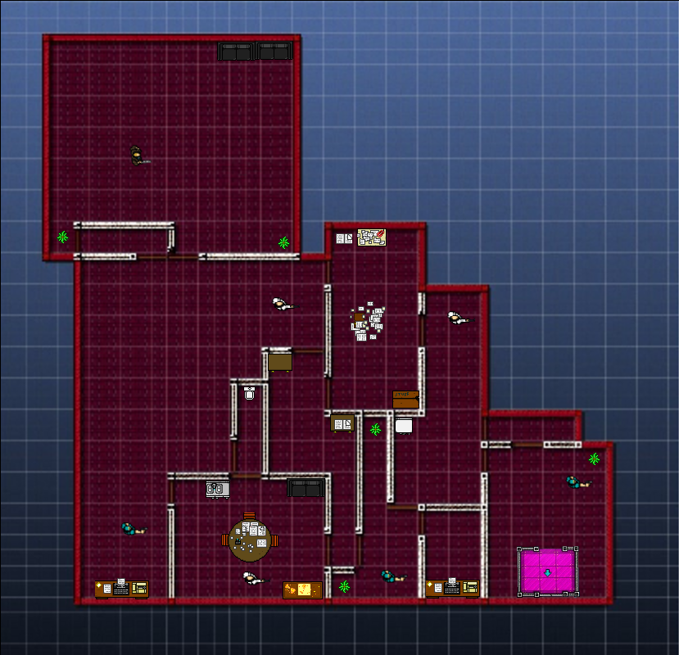
Core MECHANICS OF THE GAME:
Ascend And Annihilate Components:
1-Top Down Shooter
2-Fast Paced
3-Weapons Upgrade as Levels get Harder
4-Weapons synergize with levels
5-Forces Player to Think Tactically when clearing levels

Slide 4
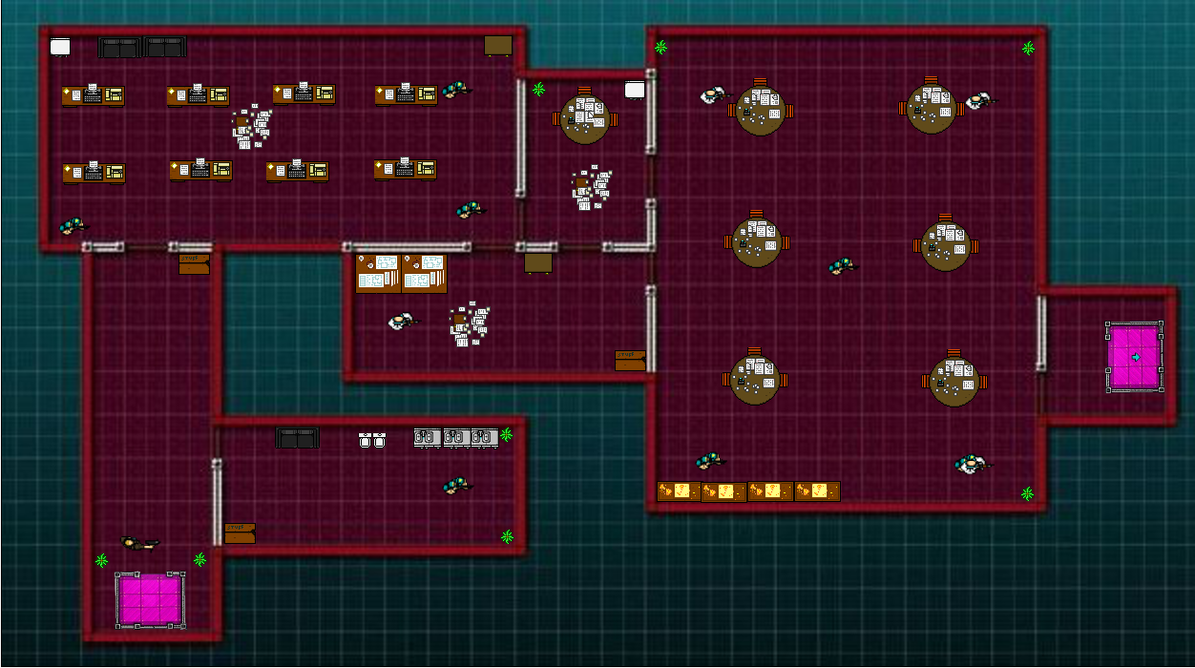
Top down shooter aspect
-See Whole Level
-See Enemies
-Plan Ahead

Slide 5
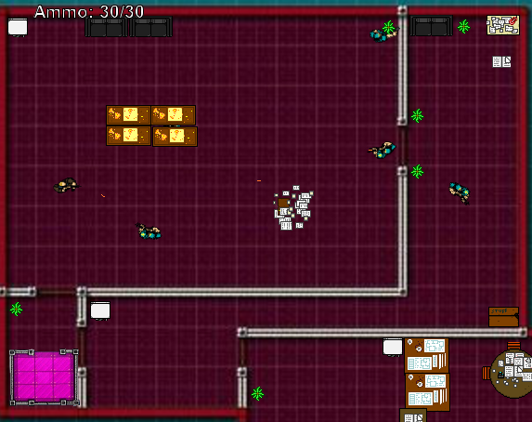
FAST PACED
-Must think of course of action for
Clearing each level
-Act quickly
-Understand your surroundings

Slide 6

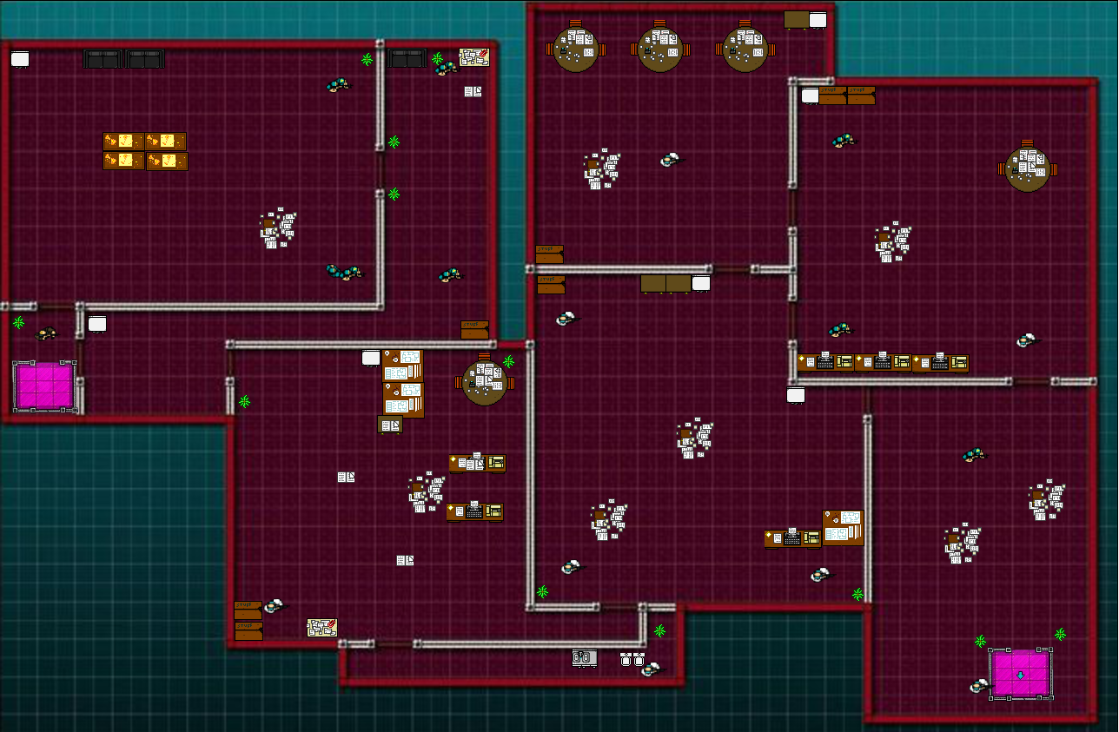
Weapons Upgrade as Levels get Harder & Weapons synergize with levels
-We can see here the weapon upgrades at each level
-These weapon upgrades oftentimes fit with the levels they are in
-Helps the player learn slowly but surely how to play the game and use the guns

Slide 7
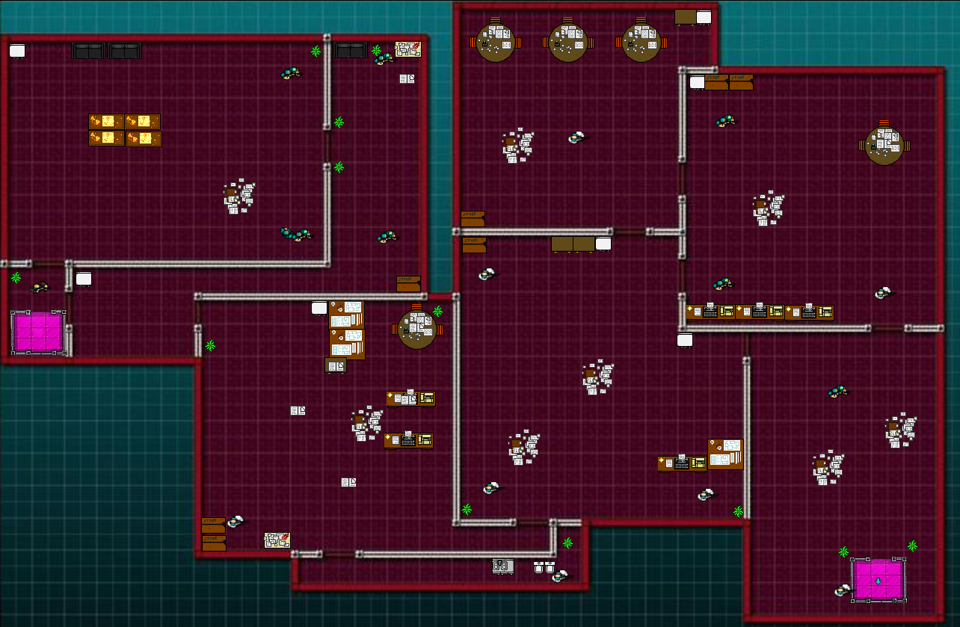
Forces Player to Think Tactically when clearing levels
-Since the game is a top down shooter, you can see the whole level. Therefore, you can think about what to do when clearing said level

Slide 8
Contributions to the Project
Luca Ragosta
-This PowerPoint
-Images of Actors/Levels
-Level Design
-Boss Fight
Steve Banh
-Transitions(Elevators)
-Walls(Invisible)
-Music(Lvls)
-Music (Transition)
Nicholas Hu
-Bullet Firing
-Enemy Movement
-Different Firing Rates
-Sprites
Andrew Sanchez
-Title Card
-Art For Title Card
-Sprites
-Walls(Collision)

Slide 9
Live-Demo

Slide 10
What went wrong
What went well
Went Well
-Concept
-Code Functioning (walls)
-Art/Level Design
-Enemy/Player Input/Functioning
-Bug Removal
Didn’t Go Well
-Audio Issues
-Bullet Shooting
-Team Coordination
-Team Coordination
-Team Coordination
-Team Coordination
-Team Coordination
-Team Coordination
-Team Coordination

